Slide 1
AGGIE GATEWAY
THE INSTITUTIONAL VISION: A UNIFIED DEGREE, LICENSURE, FACULTY & LEADERSHIP ECOSYSTEM
CO-PRESENTERS & PROJECT LEADERSHIP:
W. CHRISTOPHER HARRISON — LEAD PLATFORM & INTERFACE ARCHITECT | ASSISTANT PROFESSOR (CAES)
CHARLIE HOPPER — ERP DATABASE SPECIALIST | SMALL FARM RESEARCH & INNOVATION CENTER (SFRIC)
EXECUTIVE STRATEGIC BRIEFING FOR PROVOST DR. DONALD DAIRE | OCTOBER 9, 2026
Notes:
[OPENING REMARKS — PROF. HARRISON]
Good morning, Provost Smith-Jackson. Thank you for making time to meet with us today.
I am Chris Harrison, Lead Platform and Interface Architect for Aggie Gateway and Assistant Professor in CAES. Joining me is Charlie Hopper, ERP Database Specialist with the Small Farm Research and Innovation Center.
Together, we are here to present Aggie Gateway: a sovereign, in-house digital ecosystem engineered specifically for North Carolina A&T State University.
Over the next 12 minutes, we will show you how this platform unifies student degree velocity, zero-cost professional licensure preparation, 3D living-lab visualization, and proactive R1 research team building into one unified institutional gateway—unlocking our enterprise ERP data for students, advisors, faculty, department chairs, and your executive team with zero vendor rent.

Slide 2


THE LIVED CAMPUS EXPERIENCE
The Story: Two Sides of the Campus Silo
Why Traditional 'Journey Mapping' & Manual Admin Drown Students & Faculty Alike
JACOB THORNTON · JUNIOR STUDENT (NC A&T)
The Student Silo (7 Open Tabs): Balancing 16 credit hours across Canvas, Degree Works, Handshake, unverified spreadsheets, and a $600 external exam paywall. Zero proactive guidance.
DR. ANGELA VANCE · DEPARTMENT CHAIR & PROFESSOR
The Administrator Silo: Managing 75 advisees, paper prerequisite overrides, 6-month panic digging through faculty emails for SACSCOC & LAAB evidence binders, and isolated grant hunting.
Notes:
[THE HUMAN STORY — PROF. HARRISON]
To understand why this platform is essential, let's look at a typical Tuesday morning on our campus.
On the left is Jacob Thornton, an ambitious junior in Landscape Architecture. Jacob is balancing 16 credit hours across seven disconnected browser tabs: Canvas, DegreeWorks, Handshake, unverified spreadsheets, and external licensure prep sites demanding $600 to $900 out-of-pocket subscriptions. Jacob has zero proactive guidance connecting his daily coursework to career licensure.
On the right is Dr. Angela Vance, Department Chair. Dr. Vance manages 75 advisees, signs dozens of paper prerequisite waivers, and faces an annual panic digging through emails for SACSCOC and LAAB accreditation artifacts while hunting for federal grants in total isolation.
Both are brilliant Aggies. Both are trapped in administrative silos.

Slide 3

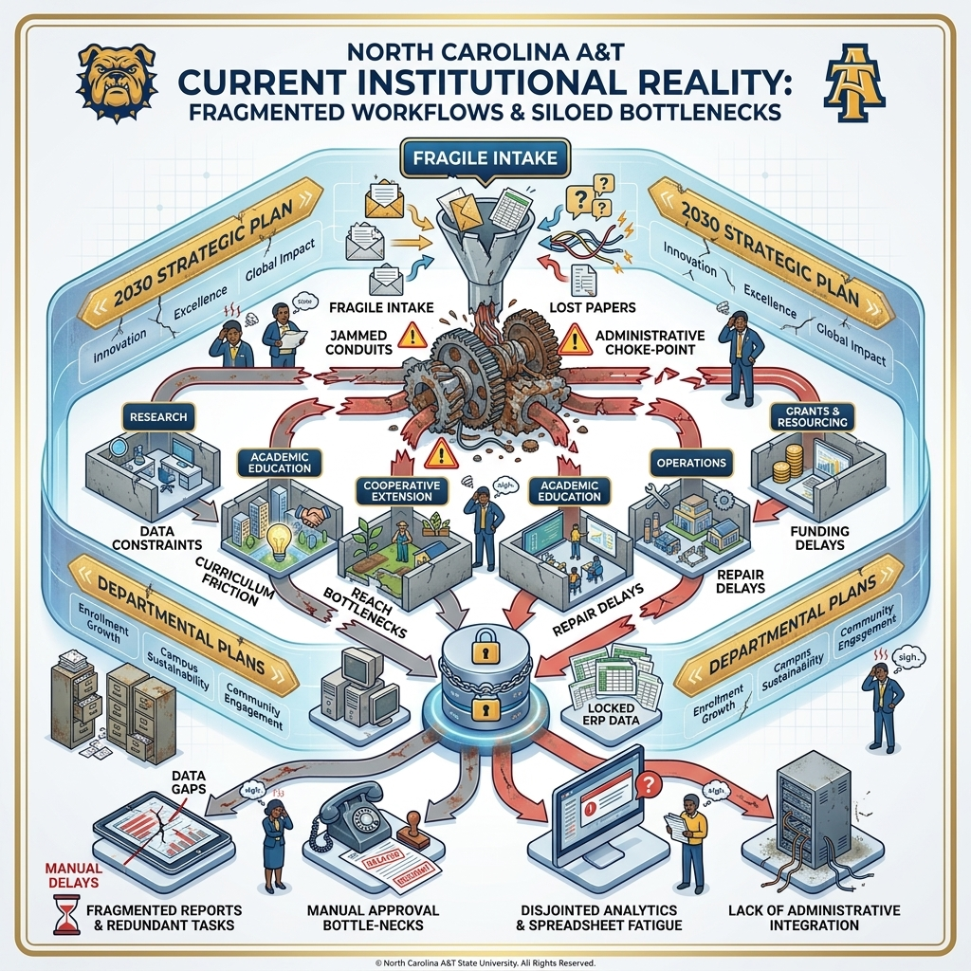

INSTITUTIONAL ANALYSIS · CURRENT REALITY
Current Institutional Reality: Disconnected Silos & Choke-Points
What We Are Doing Now: Fragile Intake, Jammed Conduits & Locked ERP Data
⚠️ Fragile Intake & Lost Handoffs
Scattered paper forms, uncoordinated email requests, and disconnected communications enter university funnels with zero automated tracking, creating immediate administrative choke-points.
⚠️ Concrete Departmental Silos
Research, Academics, Extension, Operations, and Grants are isolated in concrete bunkers with broken conduits. High-impact student living lab hours and faculty grant efforts evaporate in silos.
⚠️ Locked ERP Data & Spreadsheet Fatigue
Multi-million dollar investments in Ellucian Banner and Cayuse remain trapped behind administrative barriers. Staff and chairs resort to manual spreadsheets, causing approval delays and survey fatigue.
Notes:
[CURRENT REALITY SILOS — PROF. HARRISON & CHARLIE HOPPER]
[PROF. HARRISON]: This diagram captures our current institutional reality: what we are doing today across campus, and why it is not a smooth machine.
Notice the top: requests, applications, and student intake enter through fragile, disconnected funnels—paper forms, disparate emails, and lost handoffs. There is no automated routing.
[CHARLIE HOPPER]: Look at the center: our major campus divisions—Research, Academics, Extension, Operations, and Grants—are isolated in concrete bunkers. High-impact living lab hours and faculty grant efforts evaporate in silos.
Most critically, look at the bottom: NC A&T has invested millions of dollars in authoritative enterprise systems—Ellucian Banner, DegreeWorks, Cayuse, and Canvas. But that data remains locked behind administrative walls. Department chairs, advisors, and faculty are forced to rely on manual spreadsheets, leading to survey fatigue, delayed approvals, and compliance scrambles. We don't need another database; we need an experiential manifestation machine that unlocks the data we already own.

Slide 4
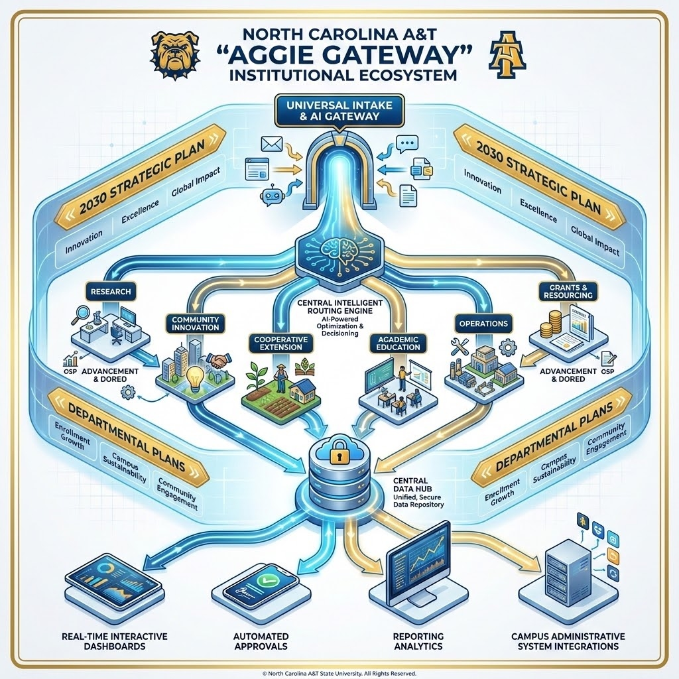
ENTERPRISE INFRASTRUCTURE · THE UNIFIED SOLUTION
Enterprise & ERP Integration: The Institutional Ecosystem
Aggie Gateway as the Smooth Manifestation Machine: Unlocking Authoritative ERP for Literally Everyone
✨ Universal Intake & AI Gateway
A unified institutional portal directly aligned with the 2030 Strategic Plan. Ingests student, faculty, and community requests, routing them dynamically through AI-powered optimization.
✨ Integrated Multidisciplinary Core
Replaces concrete silos with coordinated conduits connecting Research, Extension, Academics, Operations, and Grants into one continuous digital living lab workflow.
✨ Central Data Hub & ERP Manifestation
Bridges authoritative Ellucian Banner, DegreeWorks, and Cayuse records through secure, read-only feeds—powering real-time dashboards and automated approvals for literally every campus role.
Notes:
[ENTERPRISE ERP INTEGRATION — CHARLIE HOPPER & PROF. HARRISON]
[CHARLIE HOPPER]: Here is the unified solution: Aggie Gateway as the institutional ecosystem.
I want to be 100% clear: Aggie Gateway does NOT replace Banner or Cayuse. It serves as the experiential manifestation layer that unlocks Banner for literally everyone across campus. Through secure, read-only feeds and Role-Based Access Control, Aggie Gateway delivers curated views tailored to five distinct tiers: students, advisors, faculty, department chairs, and the Provost's executive team.
[PROF. HARRISON]: Look at the top arch: a Universal Intake & AI Gateway directly aligned with our 2030 Strategic Plan. Whether a student submits a goal, an advisor flags a bottleneck, or a community stakeholder requests technical assistance, the AI routing engine dispatches it seamlessly across our multidisciplinary core. Workflows flow smoothly from intake to central data hub, producing automated approvals, real-time dashboards, and permanent audit logs.

Slide 5



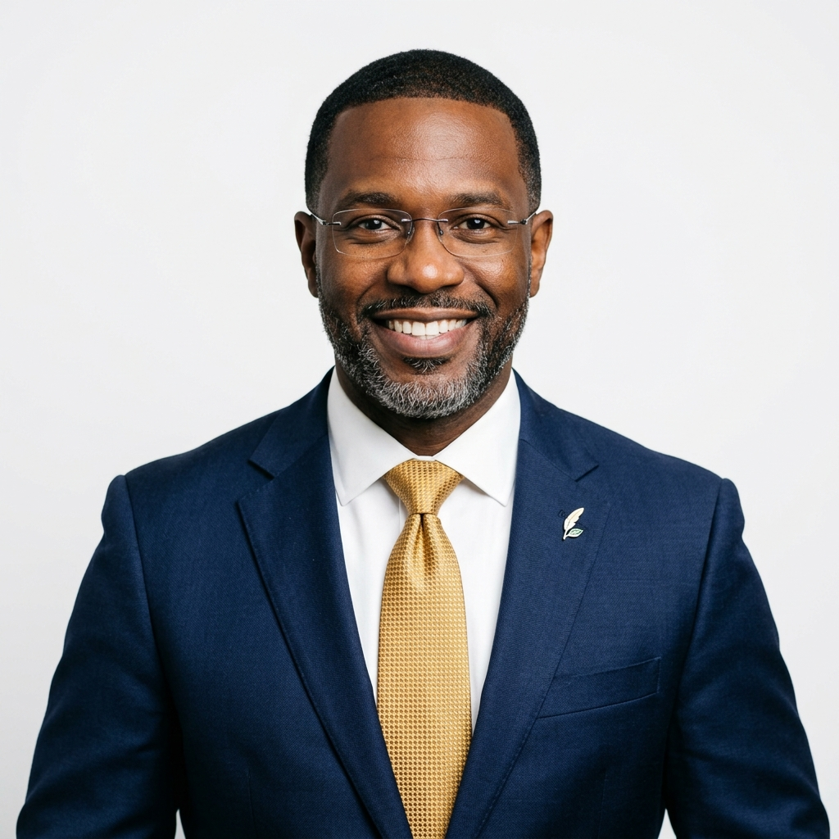

PLATFORM ENGINES
Dual Architecture: Four In-House Sovereign Engines
Specialized Tools That Function Independently or Converge Inside Aggie Gateway
The Power of Modularity
Each engine (EMMA, ISLA, AVA, GRANTED) operates as a standalone tool for deep studio drills, GIS mapping, or grant hunting.
Unified Institutional Desktop
Inside Aggie Gateway, all four unite under one login, shared records, and automated accreditation evidence harvesting.
EMMA
The Mapping & Tracking Engine
ISLA
Universal Credentialing Engine
AVA
Visualization & Digital Twin
GRANTED
Funding & Research Pipeline
All platforms share authentication, design language, and a common secure data backbone.
Notes:
[THE 4 SOVEREIGN ENGINES — PROF. HARRISON]
Aggie Gateway achieves this through a dual architecture: four modular, in-house engines that operate as powerful standalone tools for specialized work, but combine natively inside Aggie Gateway for a unified institutional experience.
First, EMMA: our degree trajectory and supplemental studio classroom engine.
Second, ISLA: our universal licensure exam prep and testing desk.
Third, AVA: our 3D spatial digital twin and living lab GIS engine.
Fourth, GRANTED: our proactive R1 research matchmaking and compliance engine.
Because we own 100% of the IP, there is zero third-party software licensing, zero vendor lock-in, and total institutional agility to customize every tool for all 7 NC A&T colleges.

Slide 6
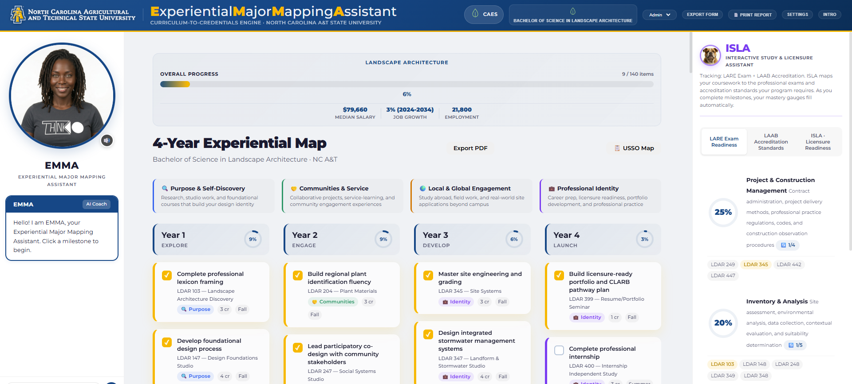
PILLAR 1 · DEGREE TRAJECTORY GPS (EMMA)
EMMA: 4-Year Experiential GPS & Degree Trajectory
Instantiated from Existing Syllabi to Track Real-Time Micro-Learning Velocity & Harvest Evidence
Notes:
[PILLAR 1: EMMA — PROF. HARRISON]
Pillar 1 is EMMA, our Experiential Major Mapping Assistant. EMMA replaces static curriculum checklists with dynamic, 4-year visual journey maps.
We don't ask faculty to spend months manually entering curriculum. EMMA instantiates directly from existing syllabi and department rubrics, decomposing semester-long courses into transparent, 8-step micro-learning timelines.
As students complete milestones, EMMA automatically tags their deliverables to professional accreditation criteria—whether LAAB for Landscape Architecture, ABET for Engineering, or SACSCOC institutional standards. What used to take chairs six months of panic before accreditation site visits is now harvested continuously throughout the semester.

Slide 7
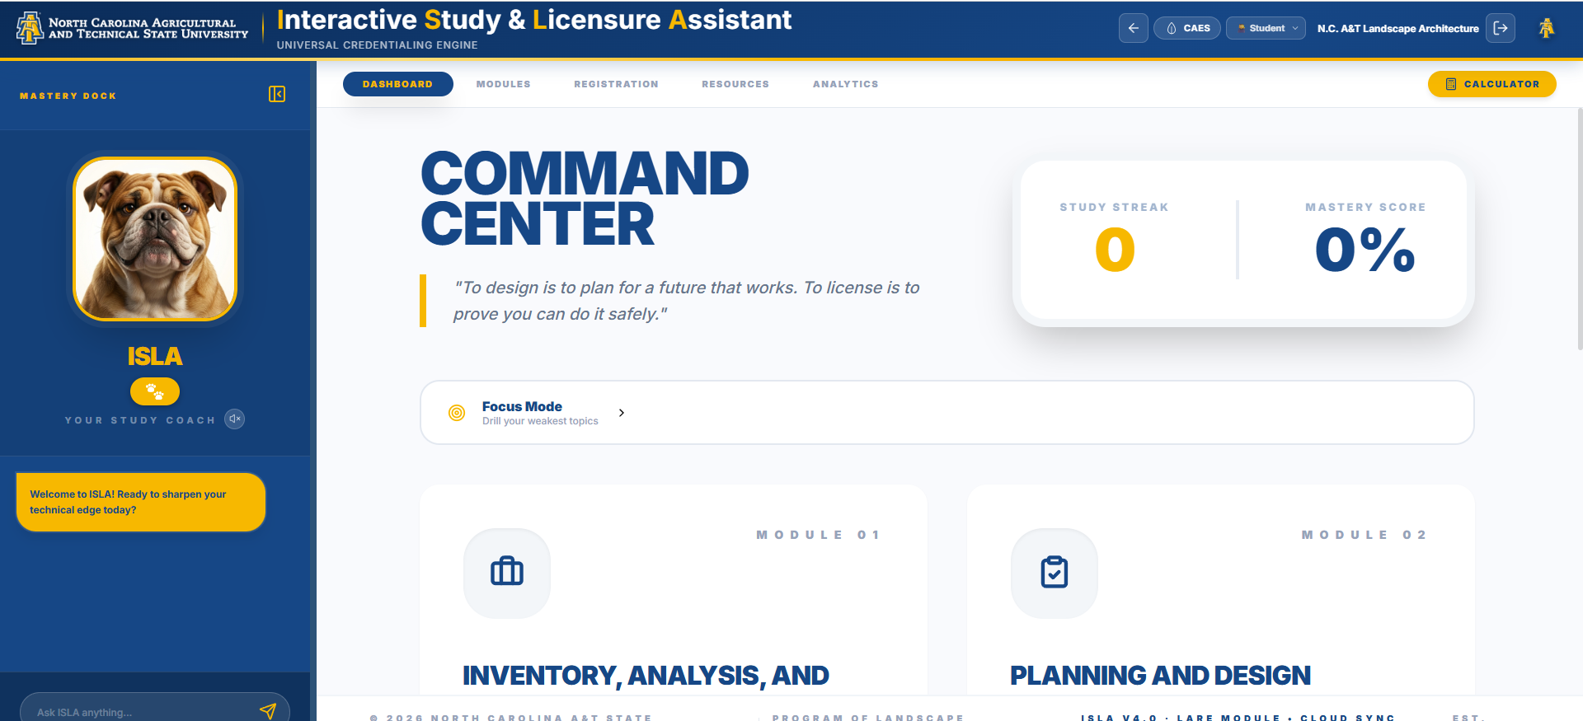
PILLAR 2 · UNIVERSAL LICENSURE (ISLA)
ISLA: Universal Licensure Exam Prep & Testing Desk
Dismantling Financial Paywalls & Accelerating Professional Pass Rates Across All 7 Colleges ($0 Cost)
Universal Testing Desk at $0
Built natively into Aggie Gateway, replacing $400–$900 commercial subscriptions (Kaplan, PPI2Pass, UWorld).
Adaptive Learning Engine
Spaced repetition flashcards (SM-2), timed Prometric mock exam simulations, and instant answer rationales.
Closing the Licensure Gap
Directly combats national disparities in licensed minority professionals (< 3% nationally) starting from freshman year.
Notes:
[PILLAR 2: ISLA — PROF. HARRISON & CHARLIE HOPPER]
[PROF. HARRISON]: Pillar 2 is ISLA, our Interactive Study and Licensure Assistant, coached by our Aggie bulldog mascot. ISLA solves one of the greatest equity barriers in higher education: professional licensure.
Commercial test prep for exams like the LARE, FE/PE, NCLEX, or Praxis costs between $400 and $900 per student. Many of our students simply cannot afford these subscriptions, contributing to national disparities where fewer than 3% of licensed design professionals are African American.
[CHARLIE HOPPER]: ISLA provides a universal testing desk natively inside Aggie Gateway at exactly zero student cost. It features SM-2 spaced repetition drills, 3D flashcards, and a full 180-minute Prometric exam simulator. Student pass rates and readiness heatmaps feed directly into department benchmark analytics.

Slide 8
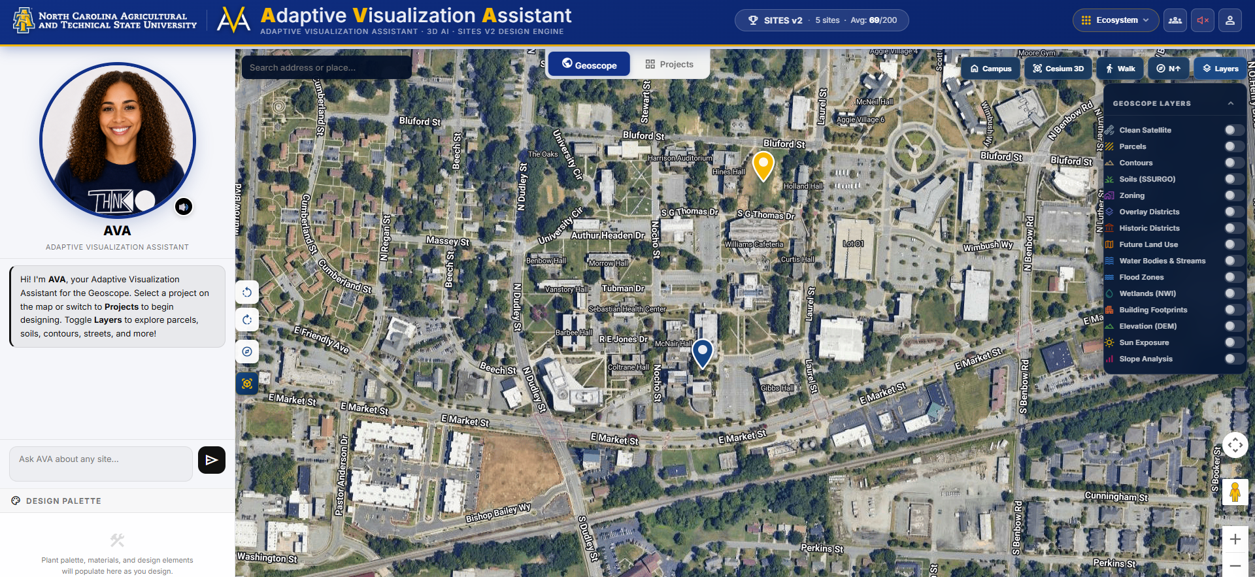
PILLAR 3 · SPATIAL DIGITAL TWIN & LIVING LAB (AVA)
AVA: 3D Spatial Digital Twin & Living Lab
Bridging Studio Classrooms to Active Research via CesiumJS, LiDAR & SITES v2
Browser-Based CesiumJS Twin
Interactive drone LiDAR terrain meshes, microclimate sensor streams, and 3D campus infrastructure.
Living Lab Field Verification
RTK rover GPS surveys and drone flights verified directly against funded grant milestones and research plots.
Native SITES v2 Calculator
Automated 250-point sustainability scorecard preparing students for LEED AP and SITES AP credentials.
Notes:
[PILLAR 3: AVA — PROF. HARRISON]
Pillar 3 is AVA, our Adaptive Visualization Assistant. Supported through USDA-NIFA capacity funding, AVA transforms our 492-acre campus and university farm into an interactive, browser-based 3D digital twin.
Powered by CesiumJS, AVA streams drone LiDAR terrain meshes, RTK GPS field survey points, and live environmental sensor data directly to students' laptops without requiring expensive CAD workstations.
Furthermore, AVA integrates a built-in 250-point SITES v2 sustainability scorecard. Students use our real campus construction and landscape projects as living lab testbeds, earning verified micro-credentials in green infrastructure before graduation.

Slide 9
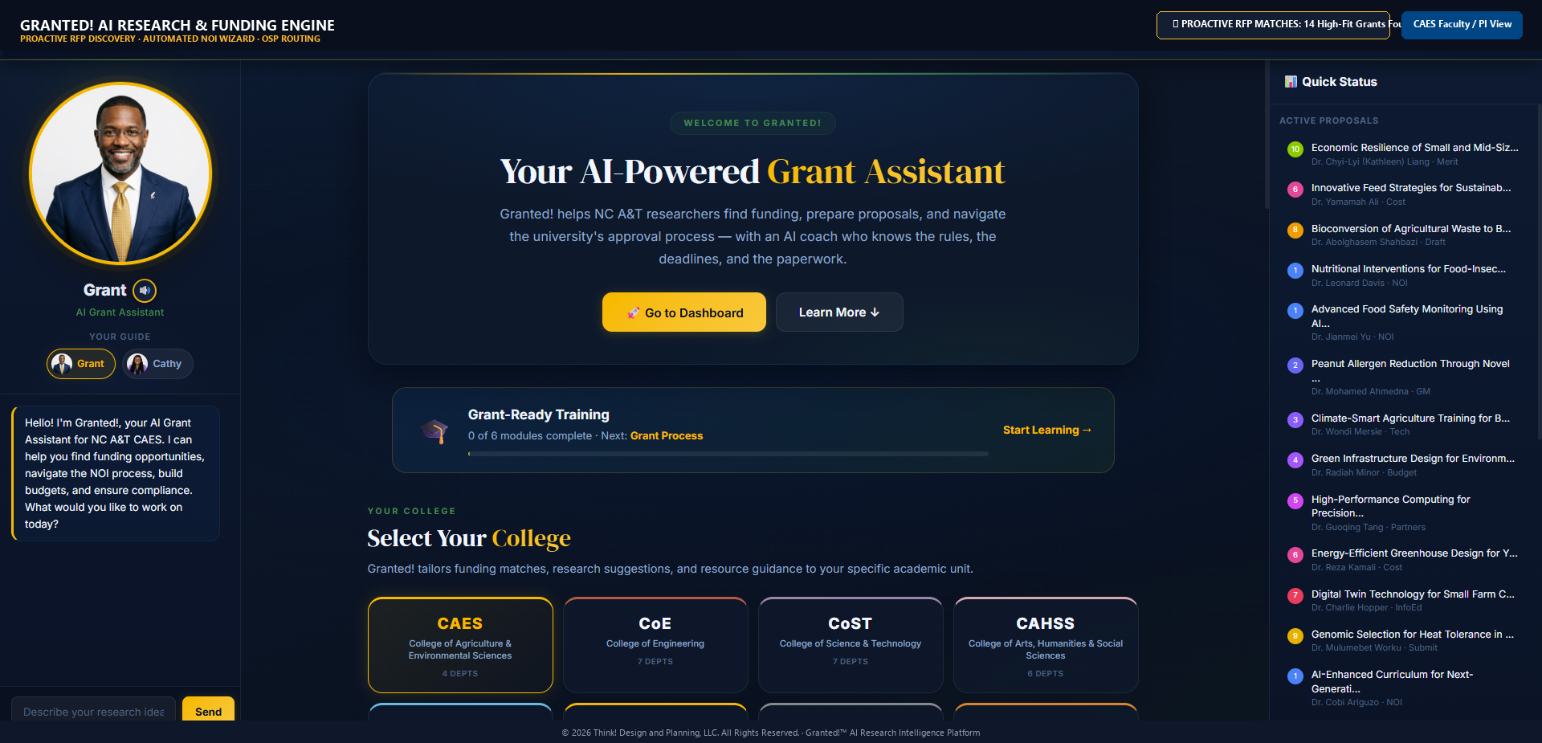
PILLAR 4 · R1 RESEARCH ACCELERATION (GRANTED)
GRANTED: Proactive Research & Team Building
Accelerating NC A&T's R1 Mission: Automatic Cross-College Teams & AI-Guided Grant Navigation
Notes:
[PILLAR 4: GRANTED — PROF. HARRISON & CHARLIE HOPPER]
[PROF. HARRISON]: Pillar 4 is GRANTED, our proactive research acceleration engine engineered to power NC A&T's R1 mission.
Instead of waiting for busy faculty to search grants.gov, GRANTED actively monitors federal RFP solicitations from USDA, NSF, NIH, and DOE, matching them against faculty expertise profiles to automatically assemble cross-college proposal teams.
[CHARLIE HOPPER]: Crucially, GRANTED incorporates an automated 2 CFR 200 compliance ledger. It tracks multi-investigator time-and-effort and cost-share ratios with mathematical precision, protecting our institutional indirect cost recovery and eliminating audit vulnerabilities.

Slide 10
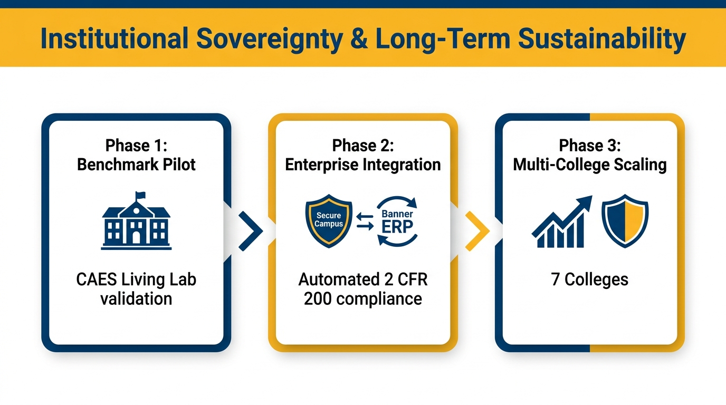
STRATEGIC SCALING
Roadmap: Phased Growth & Multi-College Scaling
A Disciplined Multi-Year Path for Institutional Sovereignty & Capacity Building
Notes:
[SCALING ROADMAP — PROF. HARRISON]
Our strategic roadmap delivers disciplined, phased growth across the university:
Phase 1 is currently active: the CAES benchmark pilot in Landscape Architecture and the Small Farm Center, validating student degree velocity and zero-cost board pass rates.
Phase 2 scales to the College of Engineering and College of Health and Human Sciences, deploying FE/PE and NCLEX-RN licensure modules and expanding cross-college R1 grant pipelines.
Phase 3 achieves comprehensive campus-wide deployment across all 7 colleges, establishing NC A&T as the national benchmark for sovereign, AI-enabled Land-Grant education.

Slide 11
OPERATIONALIZING AGGIE GATEWAY
Partnership with the Provost: Institutional Charter & Resourcing
Operationalizing Aggie Gateway via the SFRIC 1/3 · 1/3 · 1/3 Framework to Scale Campus-Wide
1/3 · PROGRAM (PEOPLE)
1/3 · TECHNOLOGY (TOOLS)
1/3 · PREDEVELOPMENT (PROJECTS)
Platform Leadership
Faculty Workload & Dev Apprentices
$10k / Month
Dedicated Cloud & AI Compute
Research Match
Campus Testbeds & Living Labs
Lead Platform Architect
Dedicated position (Prof. Harrison) with course release & summer research compensation.
Graduate Dev Apprentices
8 graduate student developer contracts to build institutional technical talent.
Enterprise Cloud Hosting
Dedicated uptime, Gemini neural TTS/vision compute, and continuous maintenance.
FERPA & Data Security
100% university-governed data sovereignty with zero commercial vendor debt.
Sponsored Research Integration
Capitalized by pairing Title III retention aid with USDA-NIFA & NSF grant matches.
Community & Campus Impact
Channels student living lab project deliverables directly into funded research.
Notes:
[PROVOST PARTNERSHIP CHARTER — PROF. HARRISON & CHARLIE HOPPER]
[PROF. HARRISON]: This brings us to our request. Aggie Gateway cannot remain an ad-hoc volunteer initiative; scaling this enterprise asset across campus requires a formal partnership charter with the Office of the Provost.
We propose operationalizing Aggie Gateway using the proven Small Farm Research & Innovation Center 1/3 · 1/3 · 1/3 framework:
First, 1/3 Program: designating platform leadership with faculty workload release and funding graduate student development apprentices.
[CHARLIE HOPPER]: Second, 1/3 Technology: approximately $10,000 per month for dedicated enterprise cloud infrastructure, high-throughput AI inference compute, and bulletproof security.
Third, 1/3 Predevelopment: pairing Title III institutional aid and departmental cost-share with sponsored research matches to treat campus living labs as active R1 testbeds.

Slide 12


Let’s Build the Future
W. Chris Harrison | wcharris@ncat.edu | Charlie Hopper | crhopper@ncat.edu
Aggie Gateway Live Platform: thinkaggiegateway.app
Notes:
[CLOSING & LIVE DEMO — PROF. HARRISON]
In closing, Provost Smith-Jackson: Aggie Gateway represents sovereign North Carolina A&T intellectual property. We have eliminated vendor rent, broken down administrative silos, and built an experiential manifestation layer that unlocks our ERP for every student, faculty member, and leader on this campus.
The platform is not a theoretical mockup—it is live and fully operational right now.
With your permission, we would love to open the live Aggie Gateway system and demonstrate these workflows in real time. Thank you.

